Slide 1
JavaScript Event Handling
Ганболдын АМАРСАНАА
Мэдээлэл, компьютерийн ухааны тэнхим
МУИС, Хэрэглээний шинжлэх ухаан инженерчлэлийн сургууль
amarsanaag@num.edu.mn
ICSI301 Вэб програмчлал
2016 оны Хавар

Slide 2
Previous lecture
W3C Document Object Model to create dynamic web pages
Learn the concept of DOM nodes and DOM trees.
Traverse, edit and modify elements in an HTML5 document
Documents As Trees of Nodes
parentNode, childNodes, nodeType, nodeValue, nodeName
Documents As Trees of Elements
firstElementChild, lastElementChild, createElement, appenChild

Slide 3
Objectives
Learn the concepts of events, event handlers and event bubbling
Create and register event handlers that respond to mouse and keyboard events
Use the event object to get information about an event
Recognize and respond to many common events

Slide 4
JavaScript Event
JavaScript events,
allow scripts to respond to user interactions and modify the page accordingly
allow scripts to respond to a user who is moving the mouse, entering form data, pressing keys and much more
Events and event handling help make web applications more dynamic and interactive
Client-side JavaScript programs use an asynchronous event-driven programming model
the web browser generates an event whenever something interesting happens to the document or browser or to some element or object associated with it
For example, web browser generates an event
when it finishes loading a document
when the user moves the mouse over a hyperlink
when the user strikes a key on the keyboard

Slide 5
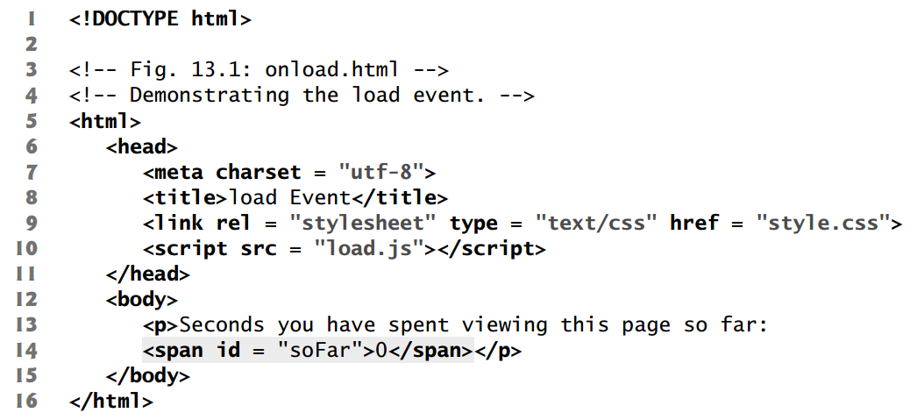
Reviewing load event
window object’s load event to begin executing scripts
This event fires when the window finishes loading successfully (i.e., all its children are loaded and all external files referenced by the page are loaded)

Slide 6
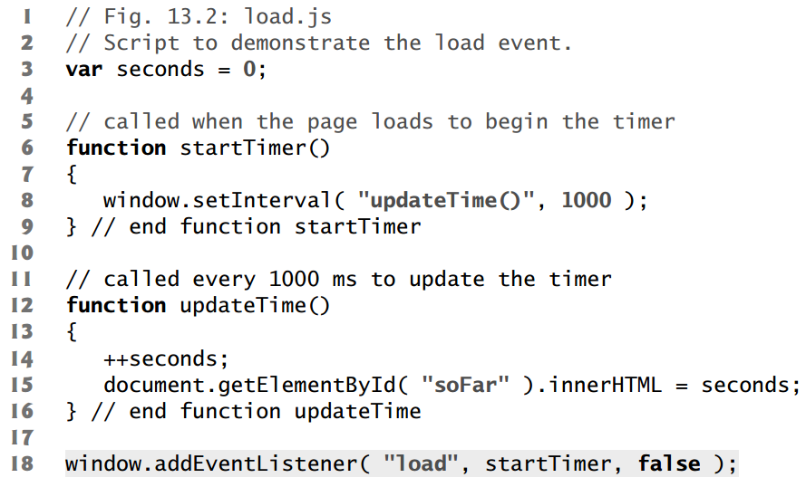
Reviewing load event [2]
An event handler is a function that responds to an event.
Assigning an event handler to an event for a DOM node is called registering an event handler.

Slide 7
Reviewing load event [3]
The load event enables us to access the elements in the HTML5 page after they’re fully loaded.
If a script loaded in the document’s head section contains statements that appear outside any script functions,
those statements execute when the script loads—that is, before the body has loaded.
If such a statement attempted to use getElementById to get a DOM node for an HTML5 element in the body,
getElementById would return null.
Another solution to this problem
is to place the script as the last item in the document’s body element
in that case, before the script executes, the body’s nested elements will have already been created
<html>
<head></head>
<body></body>
<script>
global statements here;
</script>
</html>

Slide 8
addEventListener method
addEventListener() takes three arguments:
name of the event for which we’re registering a handler
function that will be called to handle the event
the last is typically false (bubbling phase)
object.addEventListener(event, function, phase)
Registering Multiple Event Handlers
Method addEventListener can be called multiple times on a DOM node to register more than one event-handling method for an event
Multiple event handlers for different events
object.addEventListener("click", function(){}, false)
object.addEventListener("mouseover", function(){}, false)
Multiple event handlers for one events
object.addEventListener("click", func1, false)
object.addEventListener("click", func2, false)

Slide 9
One event handler for multiple objects
object1.addEventListener("click", func1, false)
object2.addEventListener("click", func1, false)
this - In JavaScript, the thing called this, is the object that "owns" the JavaScript code.
The value of this, when used in a function, is the object that "owns" the function.
The value of this, when used in an object, is the object itself. The this keyword in an object constructor does not have a value.
function func1(){
this.property //accessible
}

Slide 10
addEventListener method [2]
Removing Event Listeners
to remove an event listener by calling removeEventListener with the same arguments that you passed to addEventListener to register the event handler
Older Event-Registration Models
Inline (directly in HTML code): <body onload="start()">
Traditional (property of an object): document.onload = "start()";
addEventListener is the best practice. Why?
separate JavaScript code from HTML content
dynamically (runtime) register and unregister event handlers

Slide 11
Event-Driven JS terminology
event
is not itself a technical word that requires definition.
are simply occurrences that a web browser will notify your program about
are not JavaScript objects and have no manifestation in the source code of your program
event type
is a string that specifies what kind of event occurred
for example,
mousemove (user moved the mouse),
keydown (a key on the keyboard was pushed),
load (a document (or some other resource) has finished loading from the network)
the type of an event is just a string, it is sometimes called an event name
event target
is the object on which the event occurred or with which the event is associated
A load event on a Window, a click event on a <button> Element

Slide 12
Event-Driven JS terminology [2]
event handler or event listener
is a function that handles or responds to an event
When an event of the specified type occurs on the specified target, the browser invokes the handler.
When event handlers are invoked for an object, that is to say, “fired”, “triggered”, or “dispatched” the event
event object
is an object that is associated with a particular event and contains details about that event
Event objects are passed as an argument to the event handler function
All event objects have a type property
specifies the event type and a target property that specifies the event target
In IE8 and before, only available through the global variable event, srcElement instead of target
Each event type defines a set of properties for its associated event object
E.g., a mouse event includes the coordinates of the mouse pointer

Slide 13
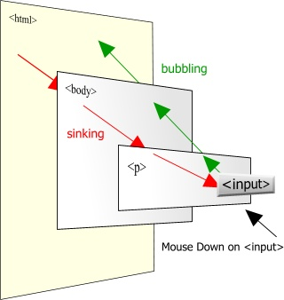
Event-Driven JS terminology [3]
Event propagation
is the process by which the browser decides which objects to trigger event handlers on
For events that are specific to a single object, no propagation is required
such as the load event on the Window object
When certain kinds of events occur on document elements, however, they propagate or “bubble” up the document tree
If the user clicks the button,
the mousedown event is first fired on the <input> element that defines that button
Then it is fired on the containing elements: perhaps a <p> element,
and the Document object itself
An event handler can stop the propagation of an event,
not continue to bubble
not trigger handlers on containing elements

Slide 14
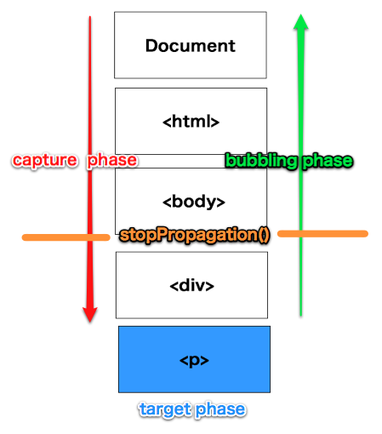
Event-Driven JS terminology [4]
Another form of event propagation, known as event capturing
handlers specially registered on container elements have the opportunity to intercept (or “capture”) events before they are delivered to their actual target
The ability to capture or “grab” mouse events is required when processing mouse drag events

Slide 15
Event-Driven JS terminology [3]
default actions
Some events have default actions associated with them.
When a click event occurs on a hyperlink, for example, the default action is for the browser to follow the link and load a new page.
Event handlers can prevent this default action by returning an appropriate value, invoking a method of the event object, or by setting a property of the event object.
This is sometimes called “canceling” the event

Slide 16
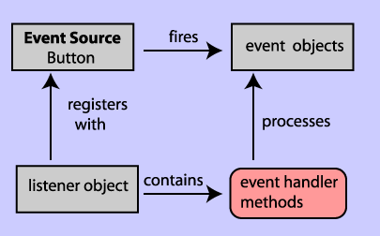
All in One

Slide 17
Types of Events: Event categories
Device-dependent input events
directly tied to a specific input device, such as the mouse or keyboard.
E.g.,
legacy event types such as “mousedown”, “mousemove”, “mouseup”, “keydown”, “keypress”, and “keyup”
new touchspecific events like “touchmove” and “gesturechange”
Device-independent input events
input events that are not directly tied to a specific input device
E.g., the click event indicates that a link or button (or other document element) has been activated.
This is often done via a mouse click, but it could also be done by keyboard or (on touch-sensitive devices) by gesture
User interface events
UI events are higher-level events, often on HTML form elements that define a user interface for a web application
E.g.,
the focus event (when a text input field gains keyboard focus)
the change event when the user changes the value displayed by a form element
the submit event when the user clicks a Submit button in a form

Slide 18
Types of Events: Event categories [2]
State-change events
Some events are not triggered directly by user activity, but by network or browser activity, and indicate some kind of lifecycle or state-related change
The load event, fired on the Window object when the document is fully loaded, is probably the most commonly used of these events
API-specific events
A number of web APIs defined by HTML5 and related specifications include their own event types
The drag-and-drop API defines events such as “dragstart”, “dragenter”, “dragover”, and “drop”
The HTML5 <video> and <audio> elements define a long list of associated event types such as “waiting”, “playing”, “seeking”, “volumechange”, and so on
Timers and error handlers
Timers and error handlers are part of client-side JavaScript’s asynchronous programming model and are similar to events.

Slide 19
Form events
Submit and Reset
<form> elements fire submit events when the form is submitted and reset events when the form is reset.
The submit and reset events have default actions that can be canceled by event handlers, and some click events do, too
Button-like form elements (including radio buttons and checkboxes) fire click events when the user interacts with them.
Form elements that maintain some kind of state generally fire change events when the user changes their state by entering text, selecting an item, or checking a box
For text input fields,
a change event is not fired until the user has finished interacting with a form element and has tabbed or clicked to move focus to another element.
Focus and Blur
Form elements respond to keyboard focus changes by firing focus and blur events when they gain and lose the focus.
The focus and blur events do not bubble, but all the other form events do

Slide 20
Window events
Window events represent occurrences related to the browser window itself, rather than any specific document content
The load event is the most important one:
fired when a document and all of its external resources (such as images) are fully loaded and displayed to the user
DOMContentLoaded and readystatechange are alternatives to the load event: they are triggered sooner, when the document and its elements are ready to manipulate, but before external resources are fully loaded
The unload event is the opposite of load: it is triggered when the user is navigating away from a document.
An unload event handler might be used to save the user’s state, but it cannot be used to cancel navigation
The beforeunload event is similar to unload but gives you the opportunity to ask the user to confirm that they really want to navigate away from your web page
The onerror property of the Window object is something like an event handler, and it is triggered in response to JavaScript errors.
It isn’t a true event handler, however, because it is invoked with different arguments

Slide 21
Mouse events
Mouse events are generated when the user moves or clicks the mouse over a document
The event object passed to mouse event handlers
properties set - the position and button state of the mouse, any modifier keys (ALT, SHIFT…) were held down when the event occurred
The clientX and clientY properties specify the position of the mouse in window coordinates
The button and which properties specify which mouse button (if any) was pressed
The mousemove event is triggered any time the user moves or drags the mouse.
occur frequently, so mousemove handlers must not trigger computationally intensive tasks
mousemove and mouseup handlers are registered as capturing event handlers
user may move the mouse faster than the document element can follow it

